Slide 1

E-learning website
BY :-
vishal KUMAR (16BCS2826)

Slide 2



Easiest way around
One tap and you can learn the course quickly.
Anywhere, anytime
Daily commute. Errand across town. Early morning flight. Late night drinks. Wherever you’re headed.
Low-cost to luxury
It saves your money as well because it free to learn on internet.
Get there! Your day belongs to you…

Slide 3
Let’s Start…
Let’s Run the HTML file

Slide 4
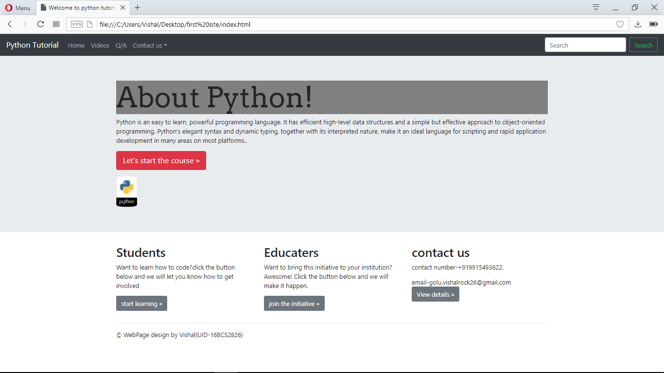
Appearance of home page

Slide 5
Here you will find the menu bar where you can manage the page, watch related videos, Q/A, and contact informations.

Slide 6
On Search bar, you can search anything related to the course

Slide 7


Click on “Let’s start the course” to avail the study materials.

Slide 8
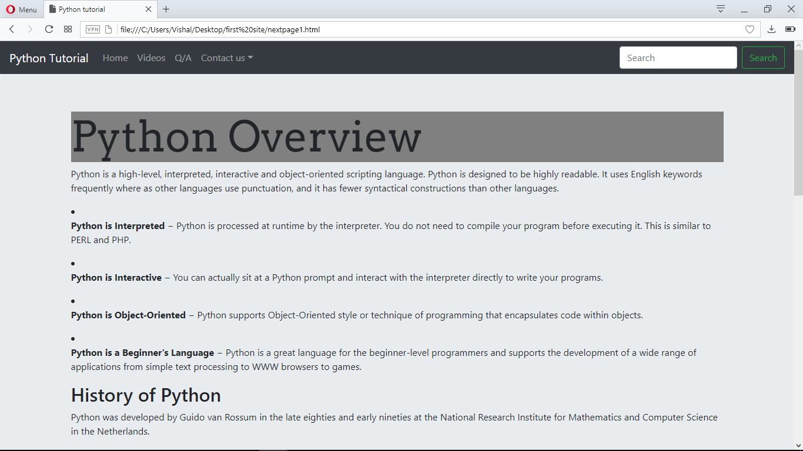

Overview after clicking on “Let’s start the course” button.

Slide 9
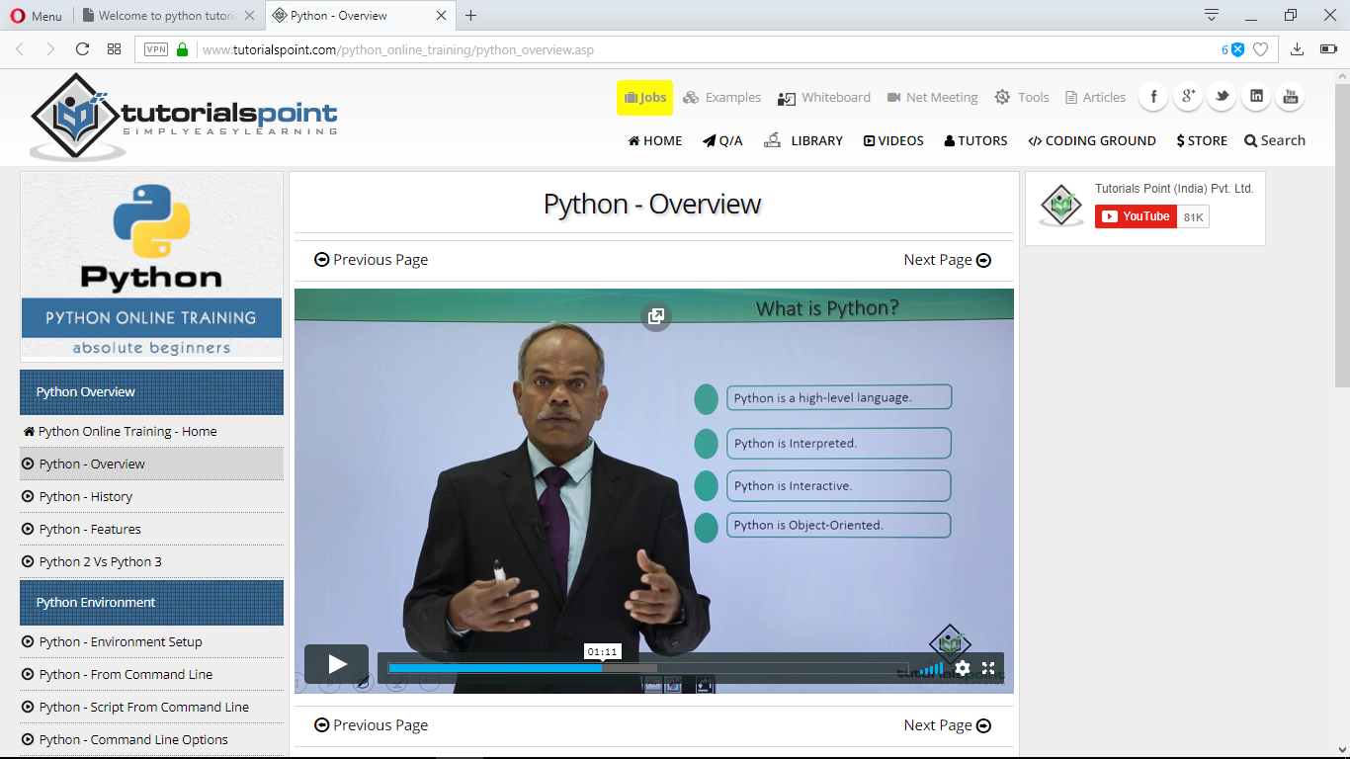
Video Section Preview

Slide 10
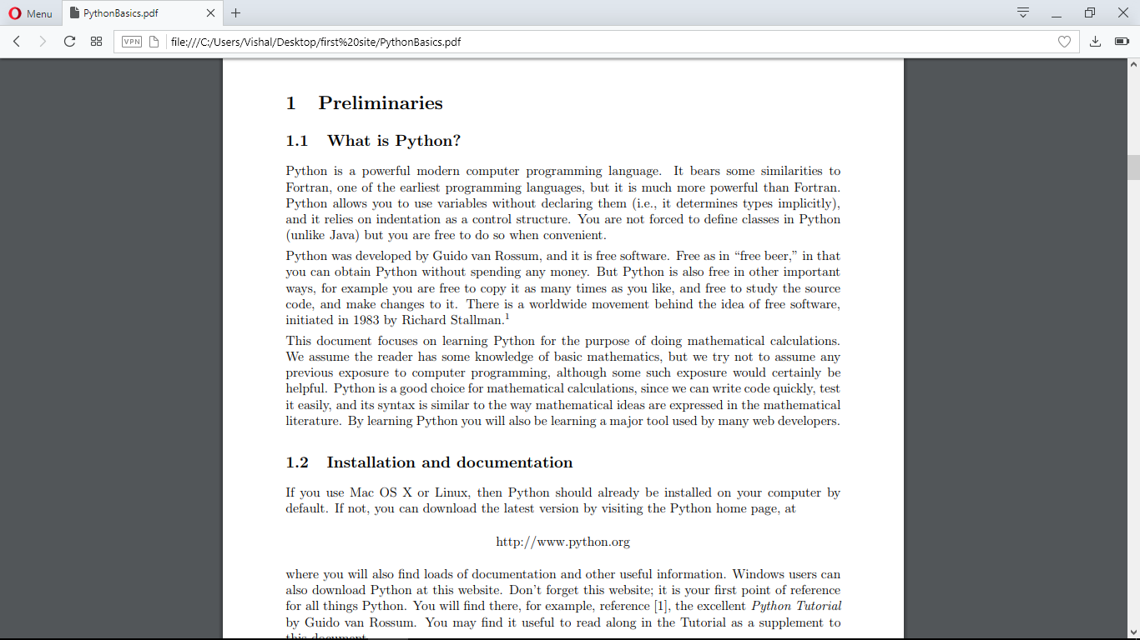
Question/Answer preview

Slide 11
And this is all about
the E-LEARNING WEBSITE.
Thanks for your kind patience

